Slide 1
LIFE OF HAZRAT MOHAMMAD PBUH IN MAKKAH

Slide 2
The life of the Holy Prophet (pbuh), was a life of
Grand success
High moral qualities
Spiritual power
High resolve
The excellence and perfection of his teaching
Perfect example
Acceptance of his prayers

Slide 3
MUHAMMAD PBUH
MUHAMMAD was the Seal of Prophets -
The last prophet of God.
To Him was revealed the Religion of Islam.
ENCYCLOPEDIA BRITANNICA:
"....a mass of details in the early sources show that he was an honest and upright man who had gained the respect and loyalty of others who were like-wise honest and upright men."

Slide 4
Arabia - before the birth of Muhammad (PBUH)
Arabia believed in a polytheistic form of religion.
There were 360 idols in Kaba
The people of Mecca, therefore, had made idols of holy and righteous persons, and these they worshipped and to these they made offerings in order to please God through them
They had developed a keen interest in Astronomy but knew nothing about Mathmatics, Geography etc.
There was in the whole of Arabia not a single school

Slide 5
It is said that in Mecca only a few individuals could read and write
From the moral point of view the Arabs were a contradictory people
They suffered from some extreme moral defects but at the same time they possessed some admirable qualities.
They were given to excessive drinking. To become drunk and to run wild under the effect of drink was for them a virtue, not a vice.

Slide 6
Woman in this Arab society had no status and no rights. Among them it was thought honourable to put baby girls to death
More than one sister could also be taken to wife by the same person at one and the same time
Polygamous marriages were very common, and there was no limit to the number of wives a man could take
there was no ban on a son's marrying his step-mother on the death of his father.

Slide 7
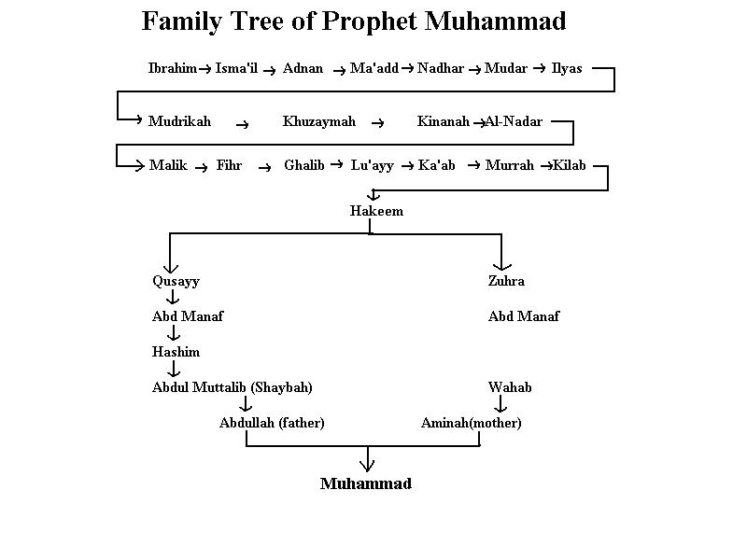

Slide 8
BIRTH OF MOHAMMAD PBUH
Abdullah was the favorite son of Abdul Muttalib.
When he was seventeen years old, he was married to Amina,
But Abdullah died only seven months after his marriage.
He (Muhammad ibn Abdullah) was born in the house of his uncle, Abu Talib, in the “quarter” of Banu Hashim in Makkah,
On the 12th of Rabi al-Awal of the Year of the Elephant, a date that corresponds to June 8, 570.

Slide 9
His foster mother was BIBI Halema
His grandfather, Abdul Muttalib, who came, took him in his arms, and gave him the name Muhammad.

Slide 10
Before Birth
Rainfall occurred and Makkah started to overflow with beauty such as trees, flowers and fruits.
Hazrat Bibi Aminah (R.A.A) was told in her dream that the child she will give birth to would be the leader of the ummah and she should name him Muhammed (S.A.W).
At the time of and After Birth:
Beautiful animals and women coming from paradise to help and comfort Hazrat Bibi Aminah (R.A.A)

Slide 11
On the morning of 12, Rabbi-ul-Awwal (August, 2, 570 A.D), when the sun was rising, the Holy Prophet Mohammed (S.A.W) was born and right away he bowed down (did the Sajdah) to Allah. Then he raised his two little hands together, made a dua and recited the first Kalimah tayyabbah.
There was no candle in the house but Hazrat Muhammed (S.A.W)’s noor (his spiritual light) was so much that it had lightened the whole world, east to west immensely. *Subhan-Allah*
(Qisa-sul-Anbiyah- Story Of Muhammed (s.a.w)’s Birth.)

Slide 12
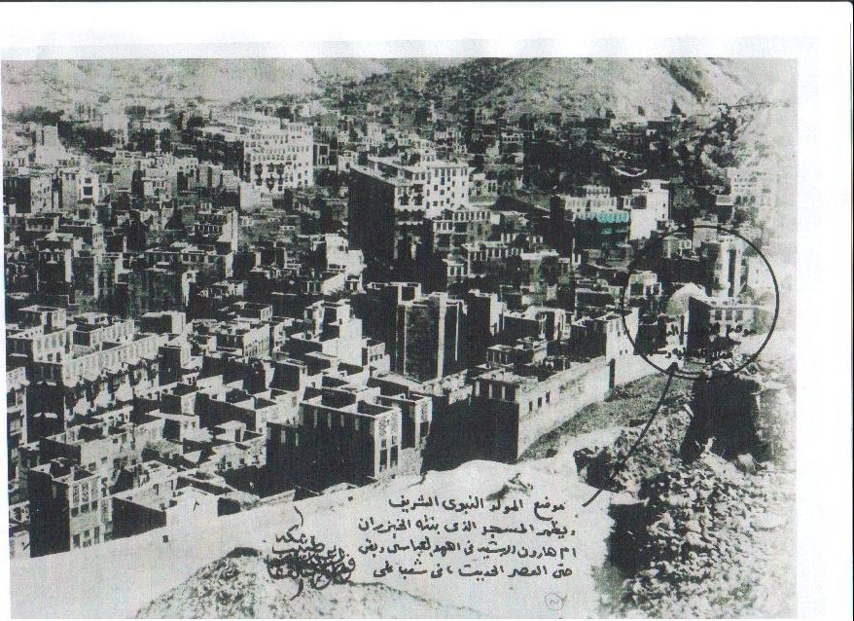
Birthplace Of Holy Prophet Muhammad (S.A.W)

Slide 13
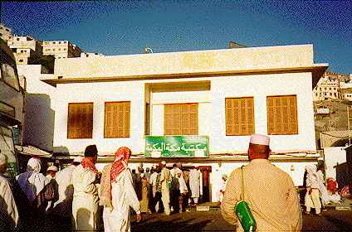

Slide 14
He was orphaned at 6 years of age.
He was taken care of by his grandfather- Abdul Muttalib & uncle- Abu Talib.
As Muhammad (S.A.W) grew up, to earn his livelihood he pastured sheep and goats.
Then he started doing trade work. In that he showed great honesty and ethics.

Slide 15
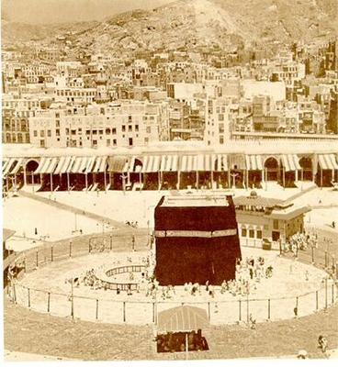
Life in Makkah
At a very young age, Muhammad (S.A.W) enthusiastically joined a pact of chivalry for the establishment of justice.
First revelation at the age of forty.
Makki Surahs were revealed.
Married to beautiful and honourable widow at the age of 25 while She was 40 years of age

Slide 16
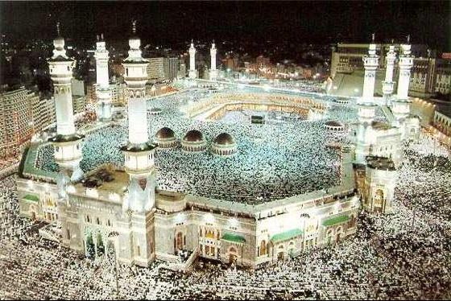
Present Day- Makkah

Slide 17
MUHAMMAD- Divine Revelations
He started to seek mediation and peace of in the Mount of Hira in of age of 40.
One day Angel Gabriel appeared before MUHAMMAD (PBUH) and said ‘‘ RECITE in the name of God’’(1-5)Surah-e-Alq.

Slide 18
It was only the being of Muhammad (PBUH) that was capable of stilling the thirst of the world
While engaged in the worship in the cave of Hira in the heart of the night, the prophet who has never studies or attended the school, was suddenly shaken by the summons,

Slide 19
Life Before & After Revelation
Before revelation:
He gained a reputation for reliability and honesty. (Al-sadiq, Al-Amin)
After revelation:
Spent in striving to spread the word of Allah.
Worshipping Allah.
Helping and guiding all.

Slide 20
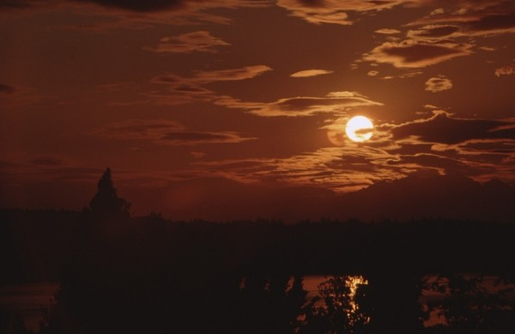
Al-Miraaj
Al-Miraaj is an Arabic word referring to the Holy Prophet’s journey, from Masjid-Al-Aqsa (which is in Jerusalem), to the heavens, and in the heavens (arsh) in one night. When he ascended beyond the seventh heaven, there he heard the Kalam of Allah, which is an attribute of Allah himself.
He also brought the gift of 5 daily prayers for all muslims.
After all these matters took place with the Prophet, he returned to the city of Makkah.
(Qisa-sul-Anbiyah: Al-Miraaj)

Slide 21
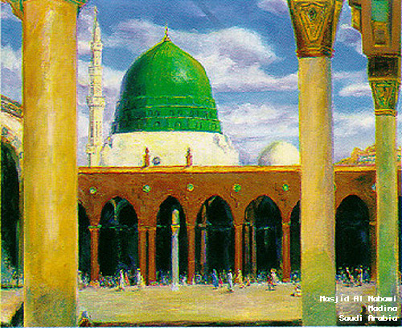
Migration To Madina & Life In Madina
By the permission of Allah, the Holy Prophet (s.a.w) decided to migrate from Makkah to Madina as the people of Quraysh were increasing their animosity towards him.
Before migrating out of Makkah, he and his companion (sahaabbah) Siddiq-e-Akbar hid in the cave of SAUR for 3 nights.
The Holy Prophet (s.a.w) and companion(s) also built a mosque together (the first mosque in islamic history)

Slide 22
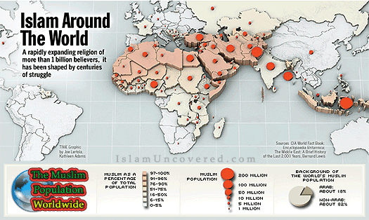

Slide 23
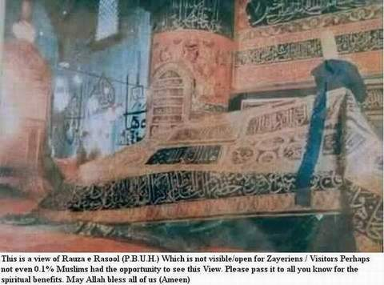
Tomb Of The Holy Prophet (s.a.w)
- A rare opportunity to view

Slide 24
Conclusion
Our beloved prophet (s.a.w) was source for mercy for us. Hazrat Muhammed (S.A.W) put all his strength in following Allah’s command and spreading Islam. He loved no one more than his ummah. HE wishes desperately for all of us to go to Paradise. Therefore it is our responsibility to send Durood and Salaam upon him. We can never reciprocate the love he has for us but this is the least we can do

